Slide 1
Digital portfolio
ARYAN KASHYAP (20BAI10072)

Slide 2
Table of contents
1. Subject Knowledge
4. Experience
2. Programming Knowledge
5. LinkedIn, Resume Link
3. Project Knowledge

Slide 3
Subject knowledge
Introduction to Problem Solving and Programming: Introduced with the essential skills for logic thinking for problem solving.
Fundamentals in AI & ML: Thoroughly learned the skills to analyse and design problems using AI techniques.
Object Oriented Programming with C++: Identified and practiced the OOPS concepts of C++.
Discrete Mathematics and Graph Theory: Learned the concepts of Discrete mathematics and graph theory to design mathematical models.
Data Structures and Algorithms: Learned to analyse fundamental knowledge of various data structures and algorithms to analyze, design, formulate and implement algorithm to real-world problem.
Operating Systems: Learned about processes, threads, scheduling techniques and other OS components.

Slide 4
Cont.
Database Management Systems: Learned how to create, manage and work on database.
Design and Analysis of Algorithms: Learned to analyse code complexities and apply approximation algorithms to solve complex problems.
Computer Architecture and Organization: Learned about computer architecture, memory systems and its organizations and interfacing techniques.

Slide 5
Programming Knowledge:
Programming Languages:
C++ (DSA)
Java (DSA, JDBC, GUI)
Python (Machine Learning, Data Science, Flask web Framework for creating Web Applications)
C

Slide 6
Web Development
HTML
CSS
JavaScript
MySQl
REACT

Slide 7
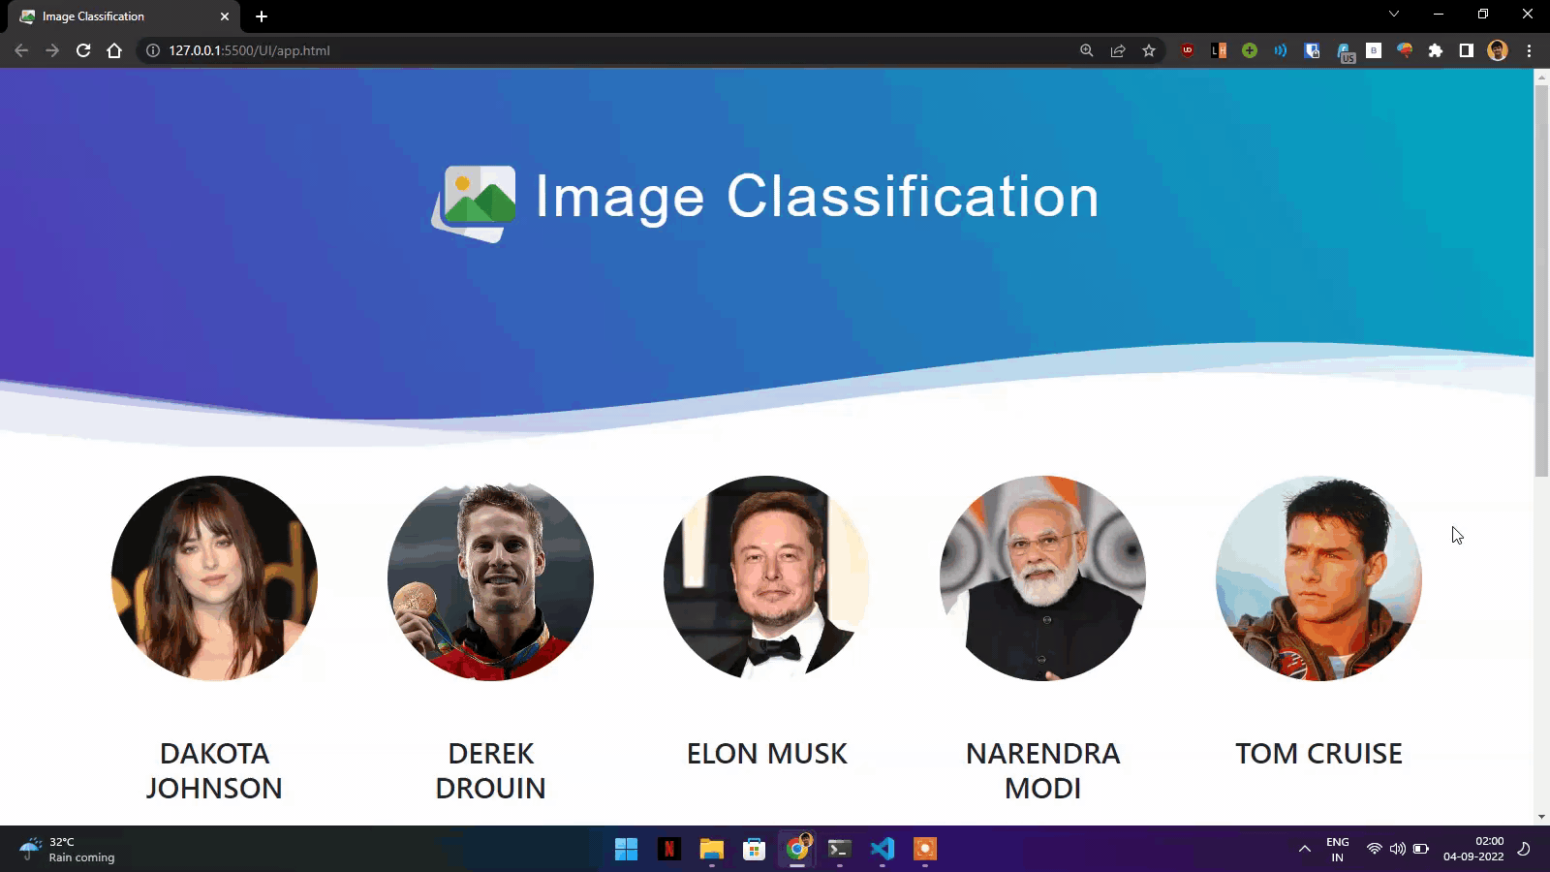
Project knowledge
FACIAL IMAGE VERIFICATION
Technologies: Flask, OpenCV, SVM, Wavelet Transform, Selenium
Overview:
Full-stack web app using Flask to classify faces based on features.
Achieved 87.5% accuracy in facial feature similarity.

Slide 8
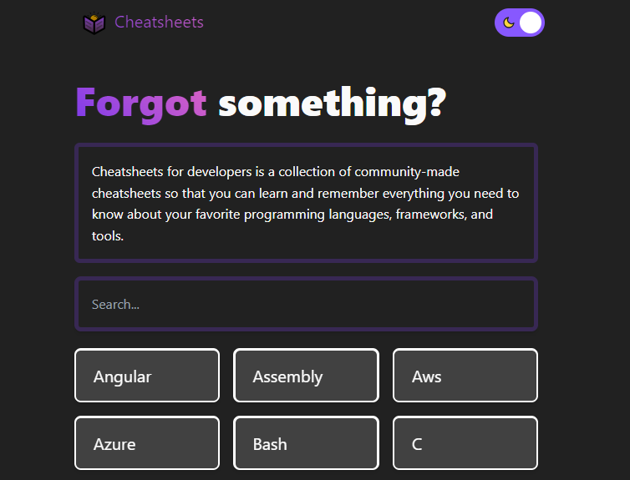
Project knowledge
DEVELOPERS NOTEBOOK
Technologies: Astro Framework, JavaScript, Python, GitHub API
Overview:
Web-based application for imperative commands, enhancing developer workflow.
Curated list with commands for over 54 languages.

Slide 9
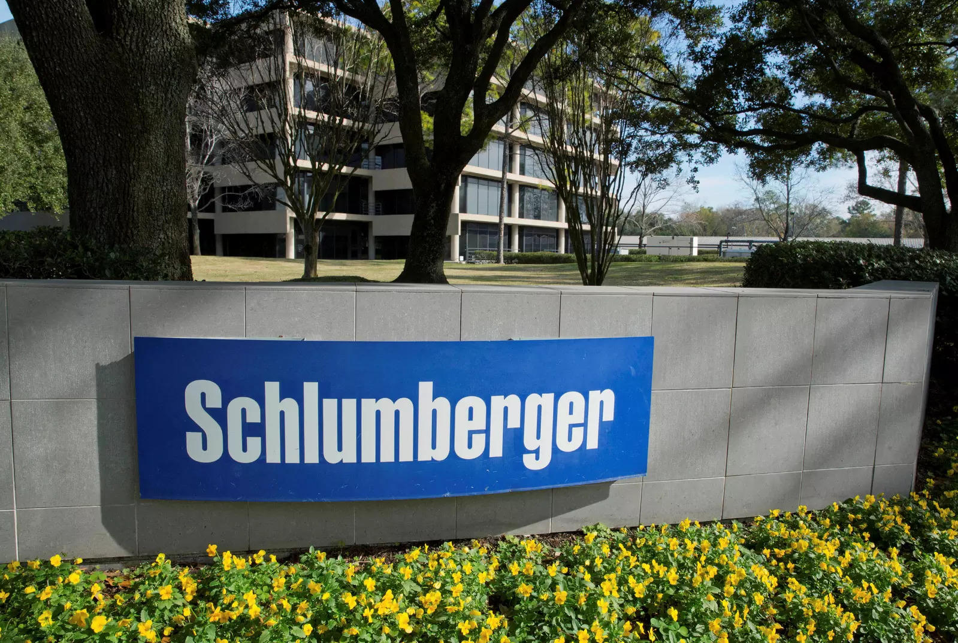

Experience
Schlumberger Internship
Position: QA Automation Engineer
Duration: May 8, 2023 – Jun 30, 2023
Achievements:
Automated meta-data validation, reducing manual effort.
Automated 10+ Aspen frontend tests, ensuring acceptance criteria.
Integrated scripts for CI/CD Aspen pipeline, enabling early bug detection.
Achieved 76.27% time savings, reducing validation time from 30m 45s to 7m 18s.

Slide 10
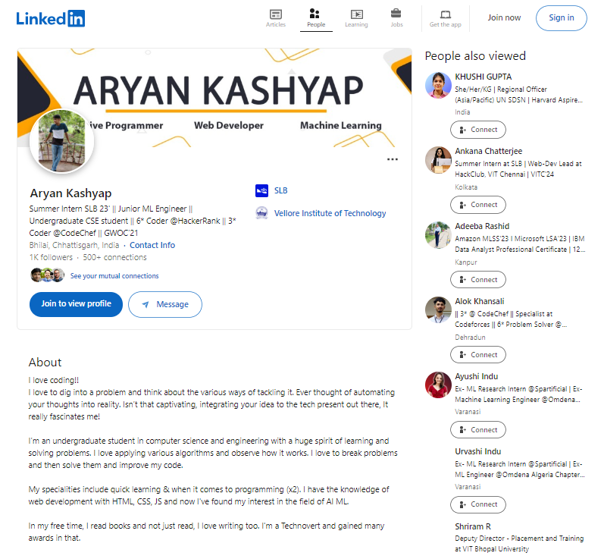
Linkedin
LINK:
https://linkedin.com/in/aryankashyap

Slide 11
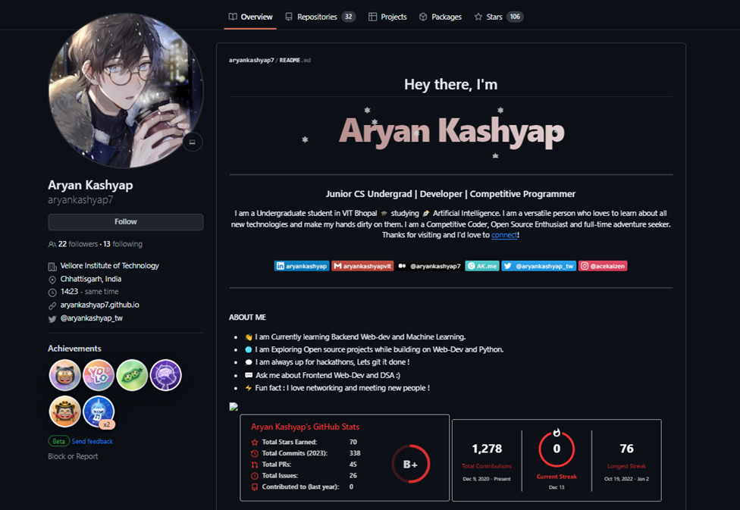
GITHUB
LINK:
https://github.com/aryankashyap7

Slide 12
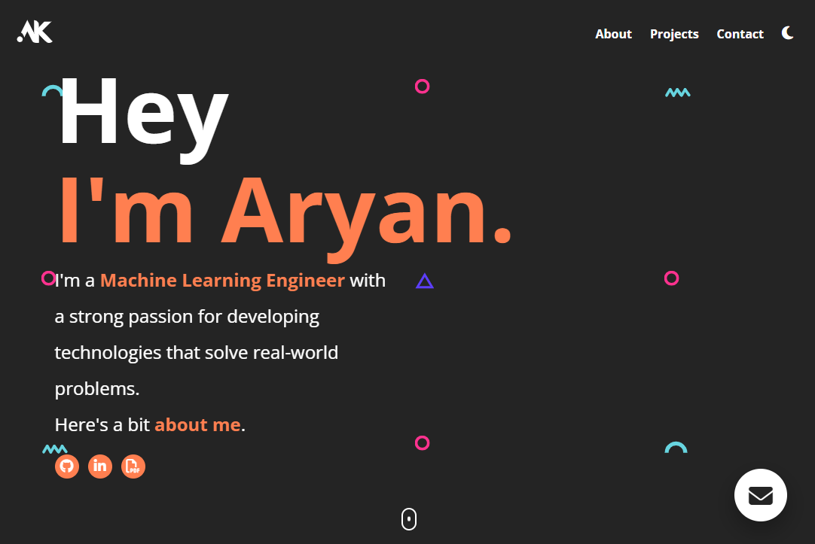
WEBSITE
LINK:
https://aryankashyap7.github.io/

Slide 13
THANKYOU

